Slide 1
Evaluation and Protection of Reinforced Concrete Structures
Jason Chodachek
Notes:
Beginning

Slide 2
Presentation Outline
Brief cause of corrosion
Non-destructive testing
Concrete and corrosion protection systems for reinforced concrete structures

Slide 3
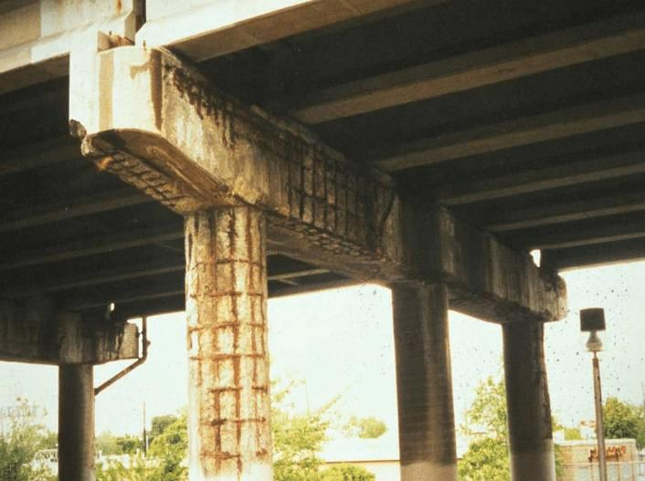
Corrosion is the #1 cause of concrete failure

Slide 4
Notes:
I want you to think of corrosion in terms of energy
Iron Ore
Let’s start by looking at how steel is made. Steel starts out as iron ore. Iron ore is in a stable, natural state. This is an image of iron ore.
CLICK 1
When we process iron ore into steel, we add lots of energy in the form of heat.
CLICK 2 – The added energy flashes
CLICK 3
The freshly manufactured steel holds onto that added energy. It is in an elevated state of energy. This is when we use it as rebar and other construction materials.
CLICK 4
Left to nature, the steel will release this added energy and return to a natural stable state, which is iron ore.
CLICK 5
Notice how the heavily corroded rebar on the far right looks very similar to the iron ore. You can see how the steel is returning to its stable, natural state.
CLICK 6
The thing to remember here is that on a basic level, steel is in an elevated state of energy. Corrosion happens when steel losses that extra energy.
Later we will look at how various solutions mitigate the release of energy.
//
This slide is setting the basic technical explanation for the corrosion process and is used to explain how the various solutions work. It is the key for the entire presentation.
In training they have to have mastery of the concept thru the training

Slide 5
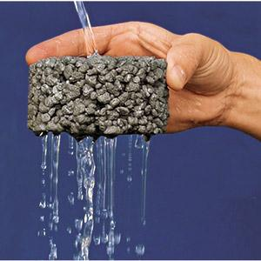
What is Concrete?
Hard Sponge (very porous)
Great in Compression
Poor in Tension
Requires Reinforcement
Highly Alkaline (pH 13+)
Notes:
Concrete is a hard sponge. It is porous and allows liquids and gases to move in and out of it’s structure.

Slide 6
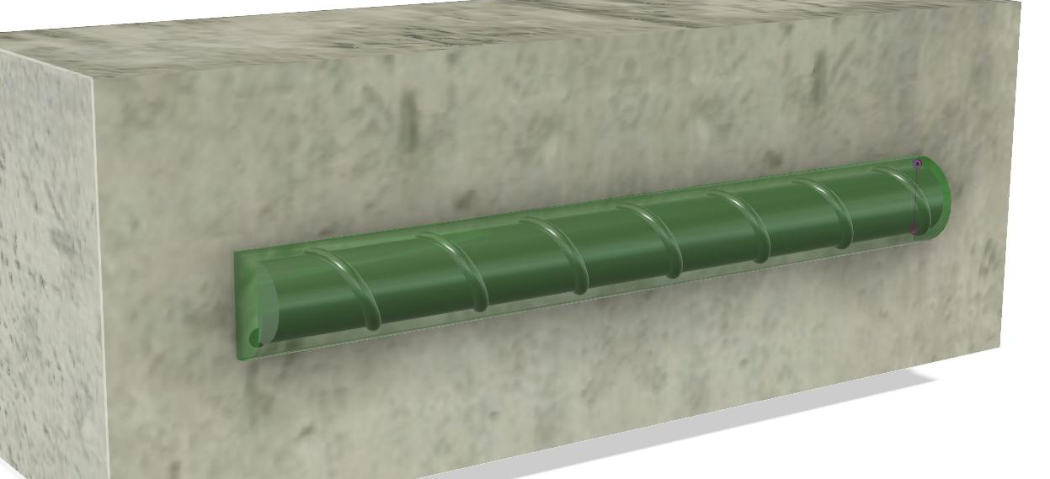
Why Concrete Protects Against Corrosion
Protective Passivation Layer
Around The Steel
“Passivation” (a protective layer)
Notes:
Quality concrete creates an environment that helps steel hold its energy.
CLICK 1
Concrete naturally has a high pH. We don’t need to dive deep into the chemistry here but this means concrete is more alkaline, the opposite of acidic. Steel naturally has a reaction with the alkaline environment of concrete that causes it to form a protective layer.
CLICK 2
This is called “passivation”. Passivation is like a natural coating that holds energy in, preventing the steel from corroding.
This is one of the things that makes concrete and steel a durable combination.

Slide 7
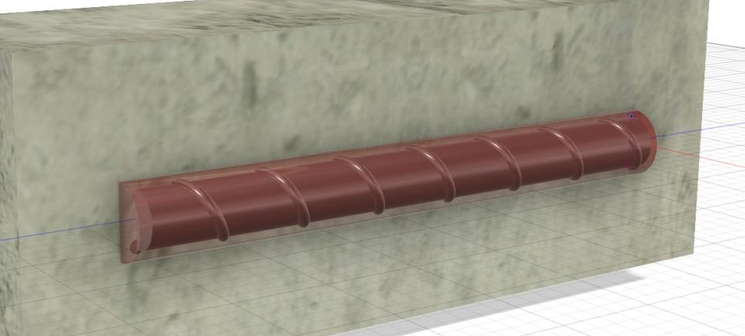
Why Steel in Concrete Corrodes?
Passivation = A protective layer that holds energy in, prevents steel from corroding
2 Main Disruptions to Passivation:
Carbon Dioxide (CO2)
Chlorides (salts)
“Passivation Layer” (BREAKS DOWN)
Notes:
If concrete protects why corroide
release of energy and supports the corrosion process (leads to)
Unfortunately, there are contaminates that can lower the pH of concrete. When this happens the passivation layer is disrupted and corrosion can begin. Two of the common contaminates are CO2 and Chlorides.

Slide 8
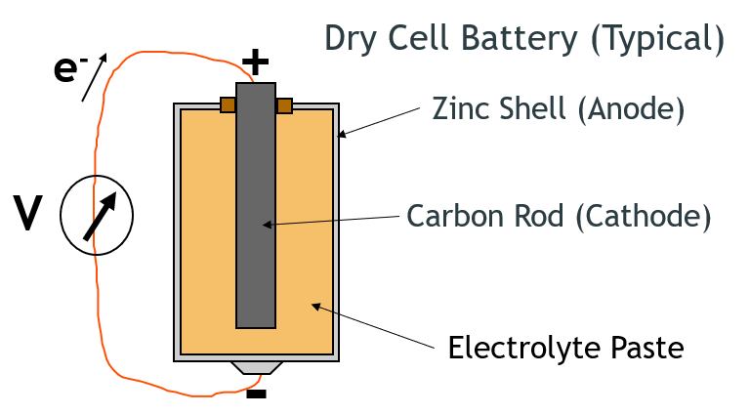
Corrosion Process
Notes:
I am going to show you why anodes are needed

Slide 9
Corrosion Cell in Concrete
Anode
Fe₃O₄
_{γ}Fe₂O₃
Fe₃O₄
_{γ}Fe₂O₃
Cathode

Slide 10
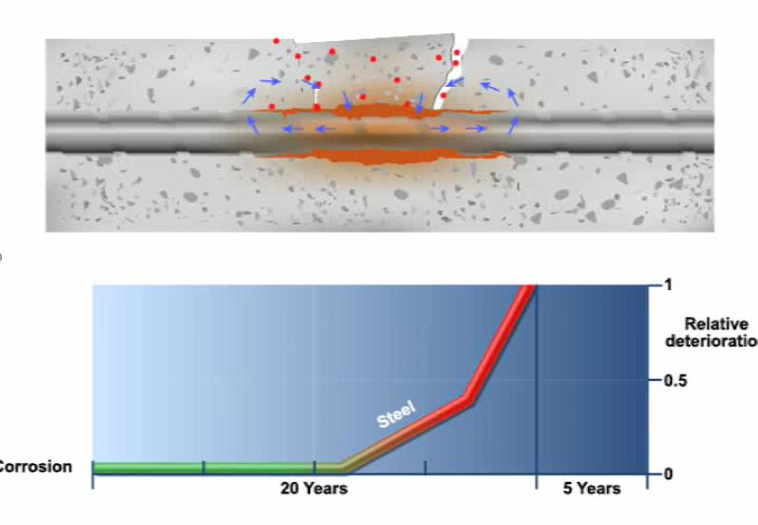
Corrosion Time Line
Notes:
Corrosion Accelerates over time

Slide 11
What should I do?
What Causes this?
Am I at Risk?
How Serious is it?
How Much Time do I Have?
How Much is it Going to Cost?
Who do I Call?????
Notes:
How to Quantify, what stratagies

Slide 12
Concrete Testing and Analysis
Quantify The Problem
Visual Inspection
Delamination Survey
Concrete Cover Survey
Cores (Strength + Other Properties)
Chloride Sampling and Analysis
pH and Chemical Testing (Carbonation)
Corrosion Potential and Corrosion Rate
Notes:
Gather data to help with your recommendations for repair or long term protection

Slide 13
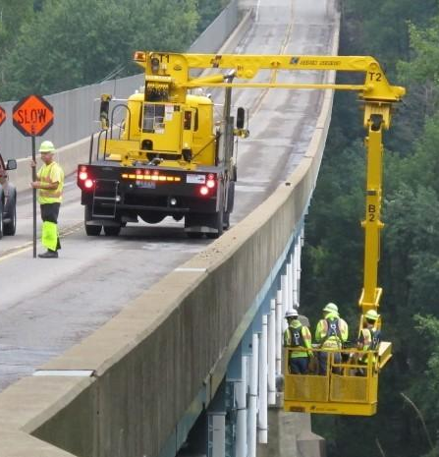
Visual Inspection
Identify areas of visual damage
Rust stains on surface
Cracks
Spalls
Exposed steel
Note exposure conditions and other observations

Slide 14
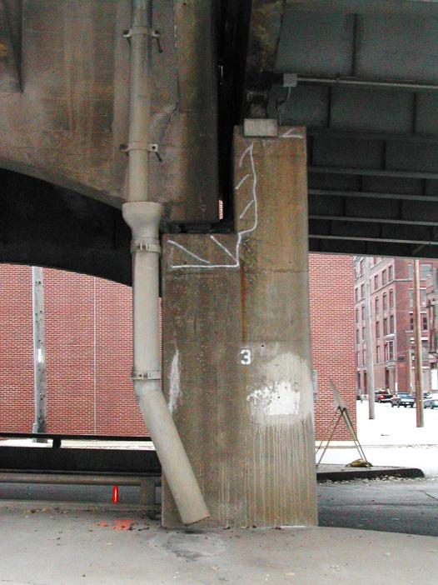
Delamination Survey
Locate areas where concrete has lost bond with rebar and delaminated concrete which has not yet spalled
Also known as “Sounding”
Hammer test
Chain drag

Slide 15
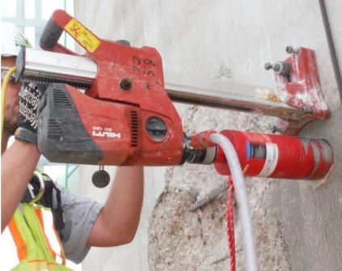
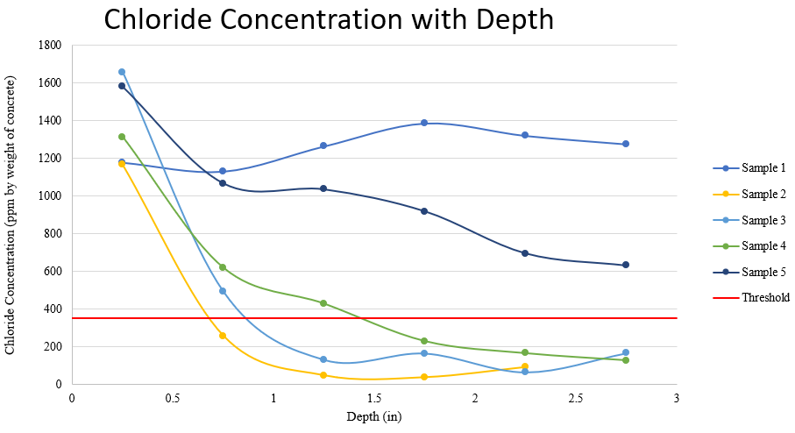
Chloride Profile Depth of Chlorides

Slide 16
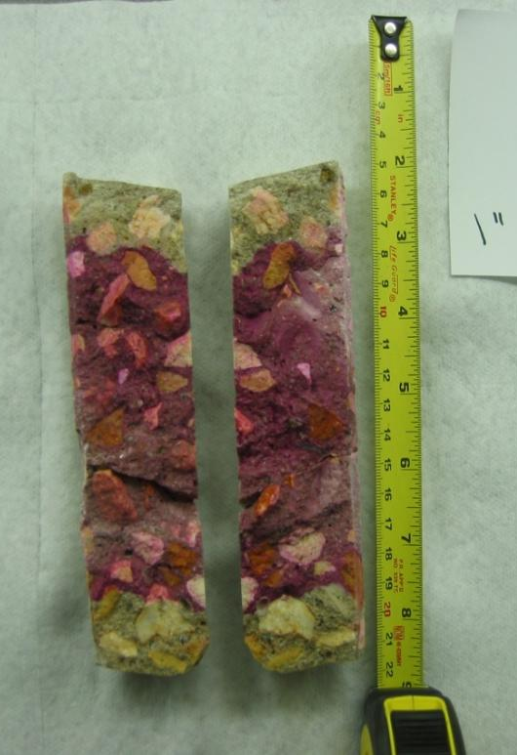
pH Testing
Mainly to determine depth of carbonation
Also some types of chemical contamination
1% phenolphthalein in alcohol or 50/50 mixture of distilled water and alcohol
Generally perceived to indicate pH of > 9.5
“Rainbow” types also available

Slide 17
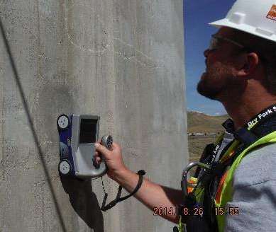
Ground Penetrating Radar (GPR)
Electromagnetic evaluation of concrete
Reinforcement layout
Location of embedded metals
Cover Depth
Compare to chloride profile or carbonation depth
Qualitative condition of reinforced concrete
Chlorides, moisture, and concrete deterioration attenuate GPR signal
Notes:
Layout or bar spacing. Quantify the amount of steel

Slide 18
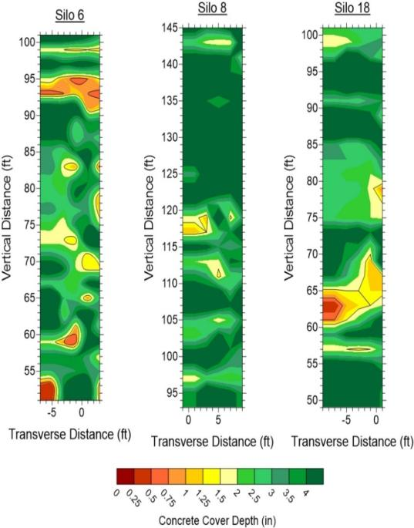
Cover Depth Survey
Steel Cover Inches
Notes:
Is the steel in a corrosive environment. This will change your protection strategy

Slide 19
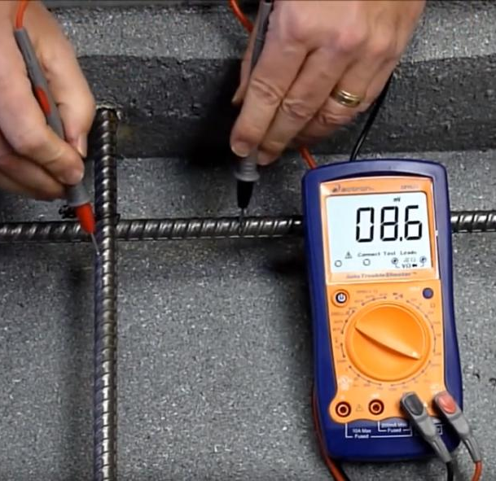
Rebar Continuity
Verify electrical continuity of the steel
Discontinuous steel may pose problems for cathodic protection
Typical Criteria
Less than 1 mV or
Less than 1 ohm resistance

Slide 20
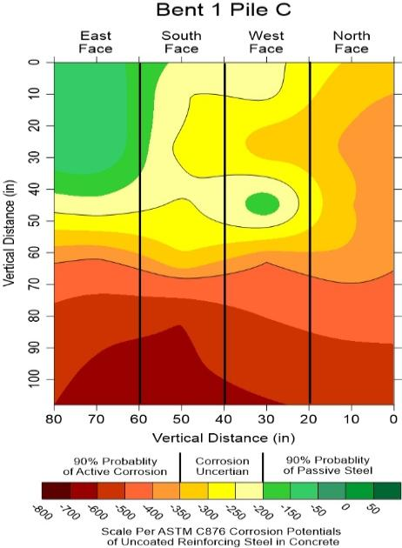
Corrosion Potentials
Measures electrical potential of the reinforcing steel (mV) and the probability of corrosion
Indication of corrosion activity when no other damage is visible
Mapping helps to identify corrosion ‘hot-spots’
Notes:
Is the entire structure corroding or just local areas

Slide 21
Selecting the Right Solution
Investigate the Structure and Situation
Condition of the Structure
Determine the Root Cause and Severity of the Risks
Shape, Size, and Characteristics of the Structure
Installation Environment
Value
Evaluate Alternatives
Technical Performance
Life Expectancy
Operations
Cost
Notes:
Condition of the structure: Corrosion Visible or Hidden
Determine the Root Cause and Severity of the Risks : Environment or construction or design defects
Installation Environment: Will the structure continue to be used during installation and what limitations does that present? How can the work areas be accessed?
Most effective repair

Slide 22
Concrete Patch Repair
Key Issues
The repaired area will be durable when good practices are followed.
The repair creates abrupt changes in chloride content and can lead to localized corrosion around the repair.
Other parts of the structure may be corroding but not damaged yet.
Halo Effect Corrosion

Slide 23
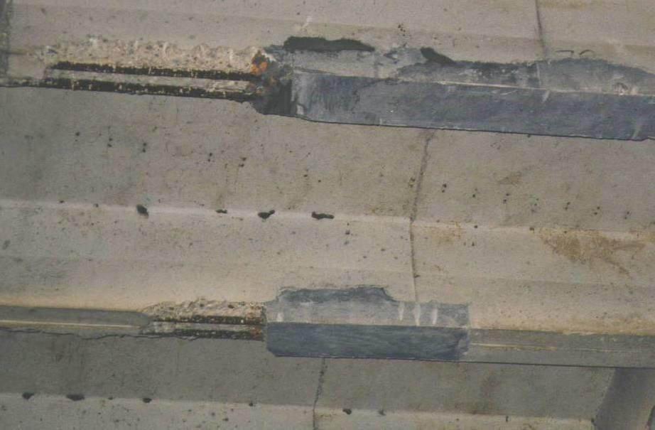
Few Years Later
Previous Patch
Failed Concrete Next to Patch
Due to Patch Accelerated Corrosion

Slide 24
Patch Accelerated Corrosion
Chloride Contaminated
Concrete
Chloride-Free Patch
-350 mV
-200 mV
Potential Difference Between Patch and
Chloride Contaminated Concrete
Results in Accelerated Corrosion
-200 mV
Notes:
Battery had potential difference

Slide 25
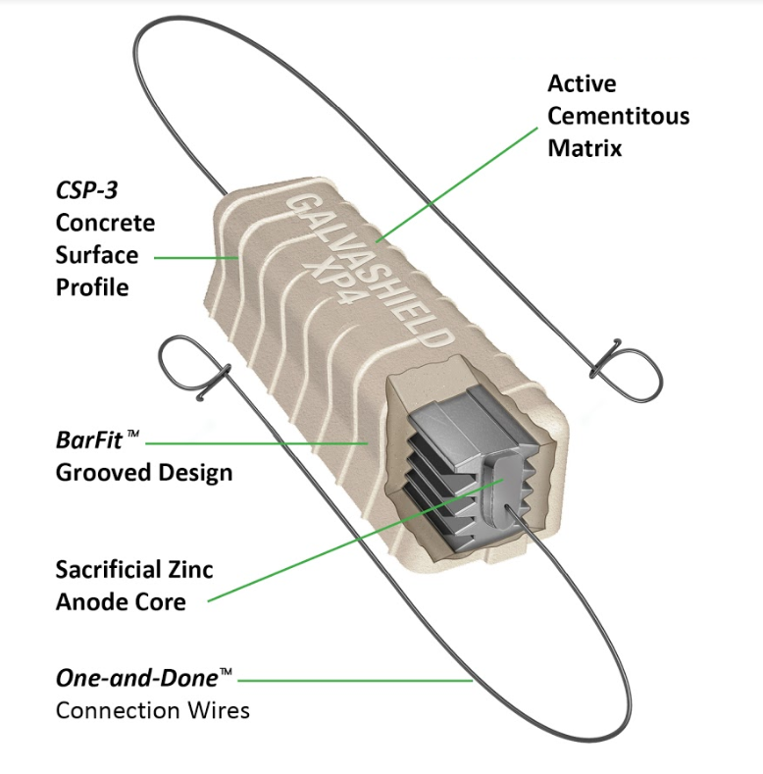
How to Prevent Patch Accelerated Corrosion?
Notes:
Why the mortar? Same as battery, Electrolytic paste

Slide 26
Installed Galvanic Anode
Chloride Contaminated Concrete
Chloride-Free Patch
-350 mV
-200 mV
-1100 mV
Anode Galvanically Protects
Surrounding Rebar
Notes:
Higher negative potential

Slide 27
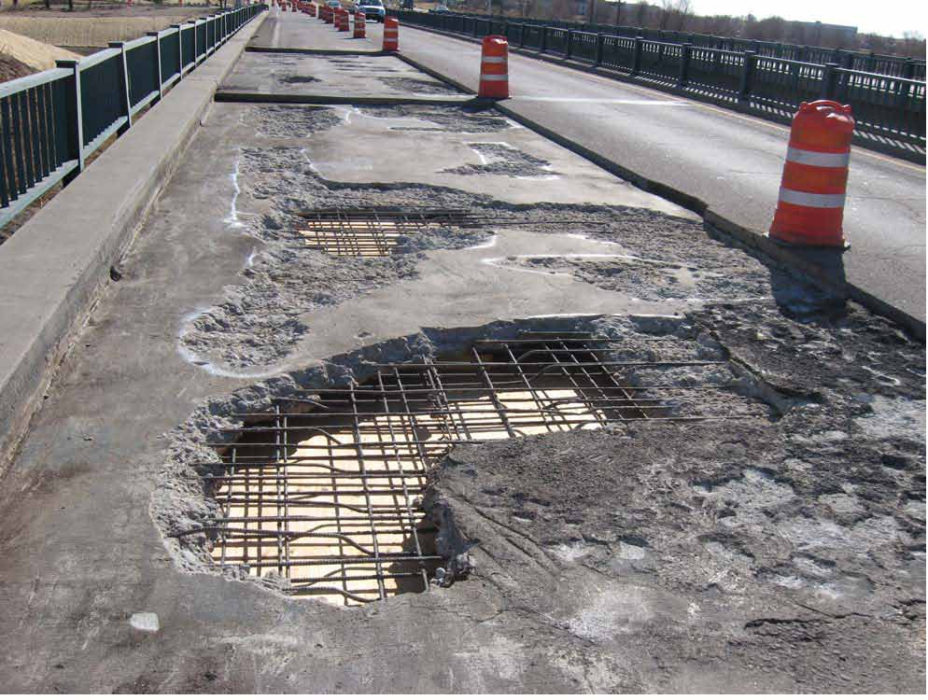
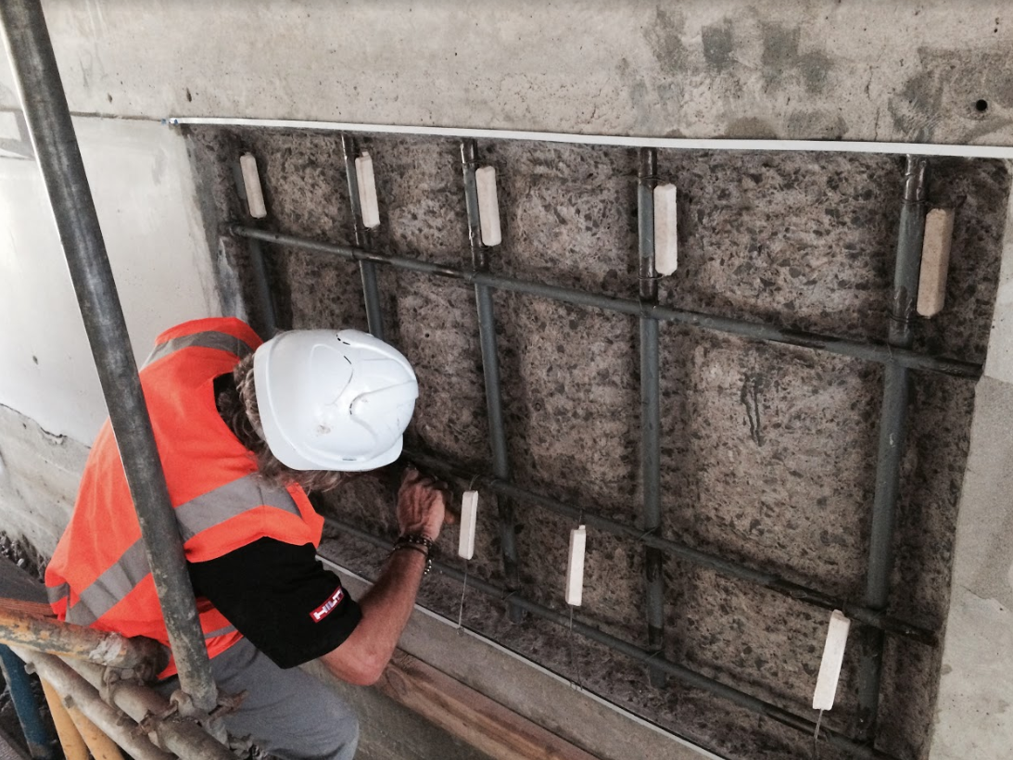
Bridge Sub Structure

Slide 28
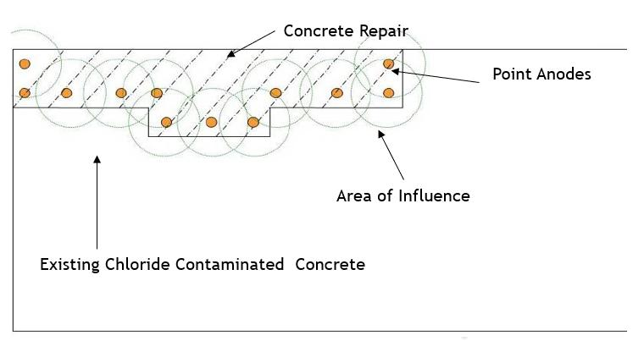
Discrete Anodes Protection (Typically for Halo Effect)
Notes:
Protection for the patch edge,
Halo
Patche corrosion

Slide 29
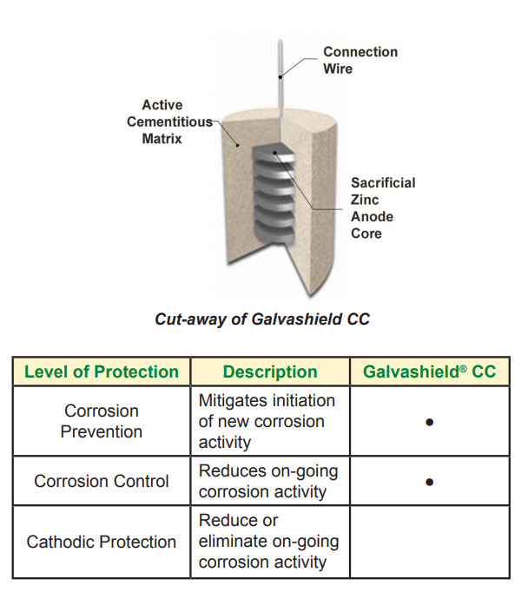
Type 2 – Drilled in Anodes
Placed proactively into sound concrete.
Global protection over large areas
Targeted protection to corrosion hotspots
Anodes applied to chloride contaminated columns prior to FRP strengthening

Slide 30
Type 2 – Drilled in Anodes

Slide 31
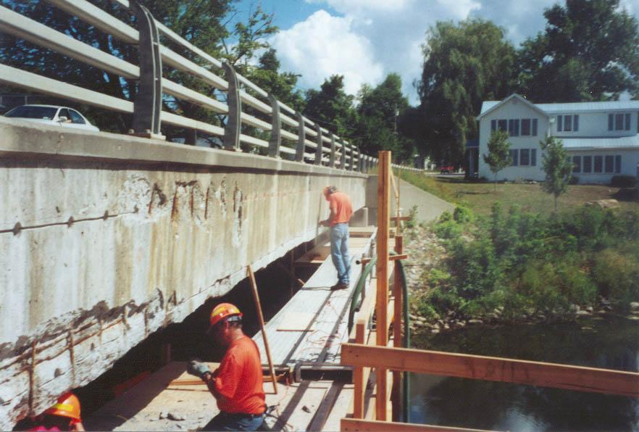
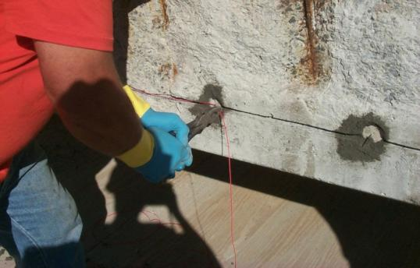

Slide 32
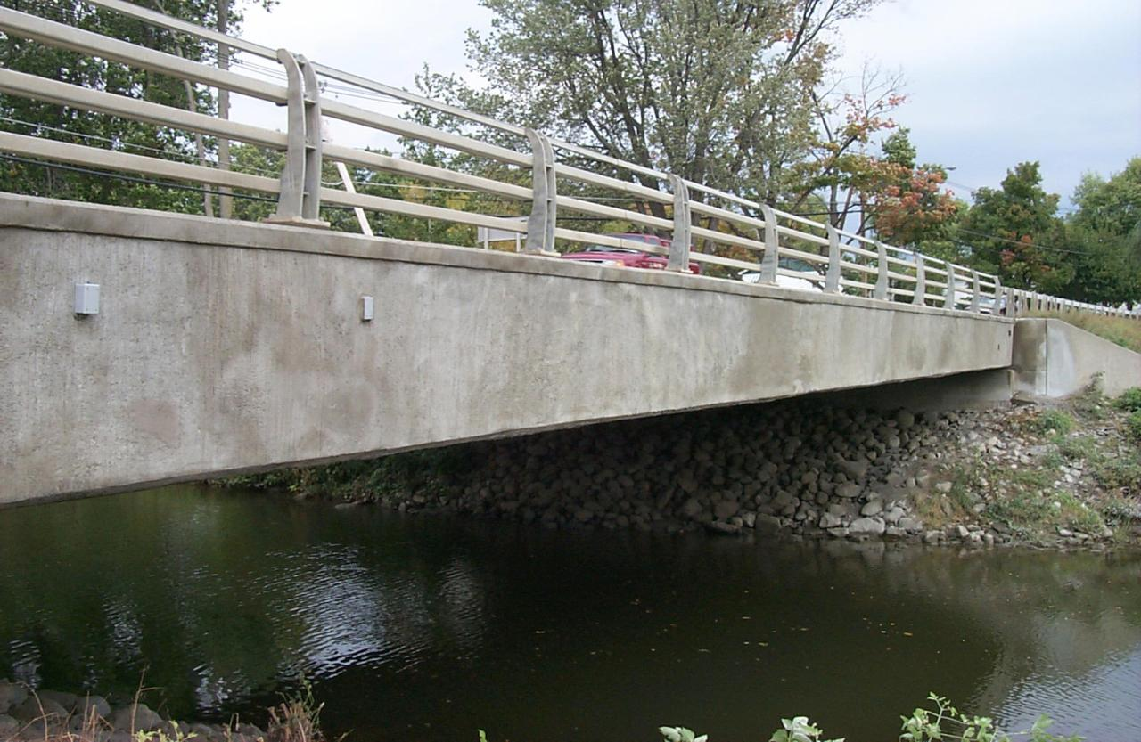
New York State Department of Transportation

Slide 33
Notes:
Global Protection

Slide 34
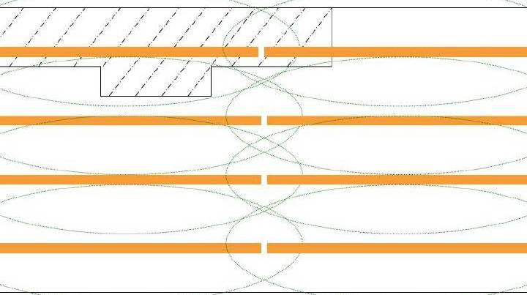
Distributed Anodes Protection
Concrete Repair
Distributed Anodes
Base Concrete
Area of Influence
Notes:
Global Protection

Slide 35
Distributed Galvanic Anodes
Distributed anode units are pre-manufactured
Zinc around a steel core
Integral connections
Anode size and spacing: based on steel-to-concrete surface area ratio and service life
Notes:
Variety of sizes

Slide 36
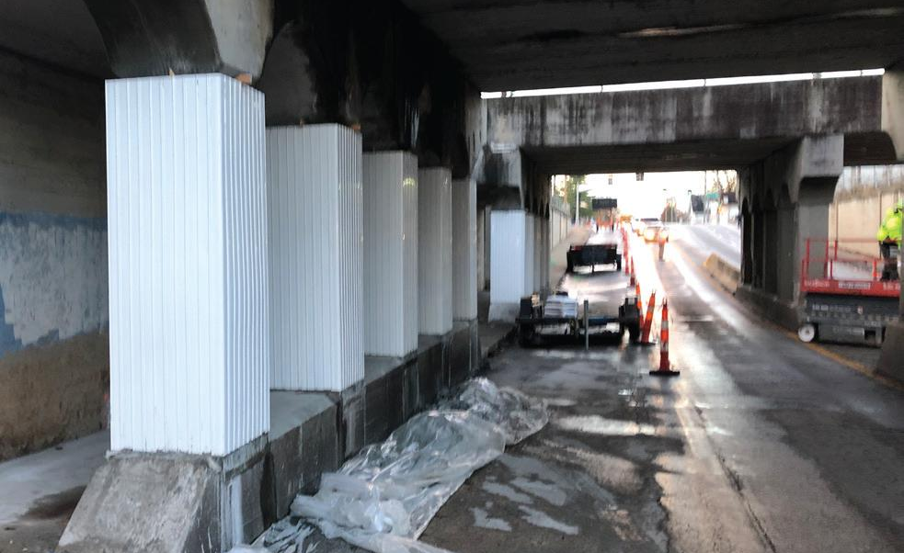
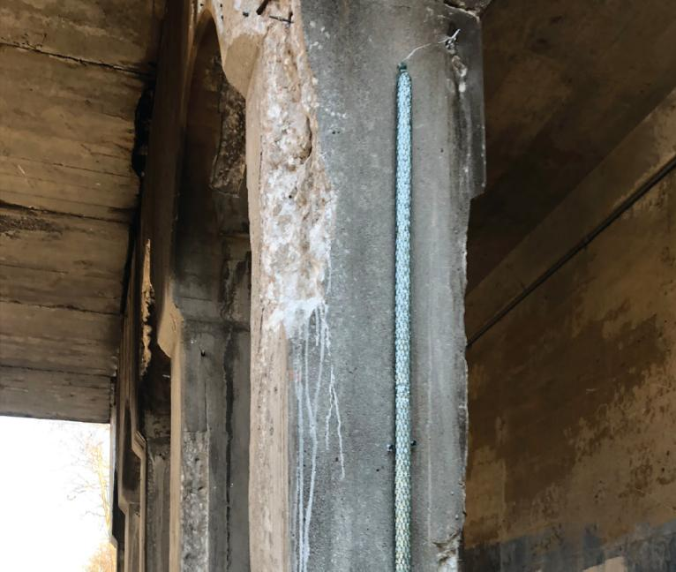
Distributed Galvanic Anodes

Slide 37
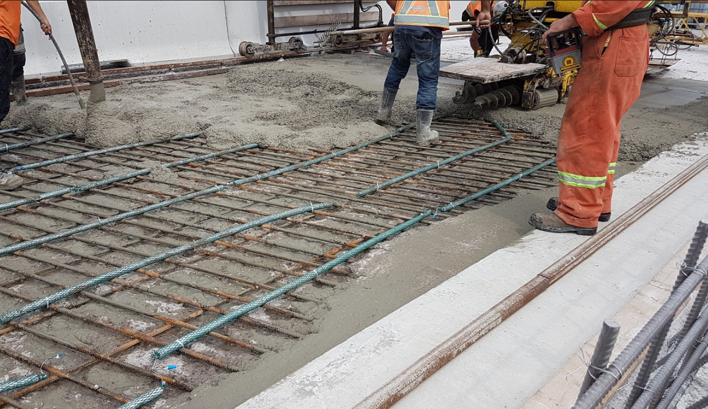
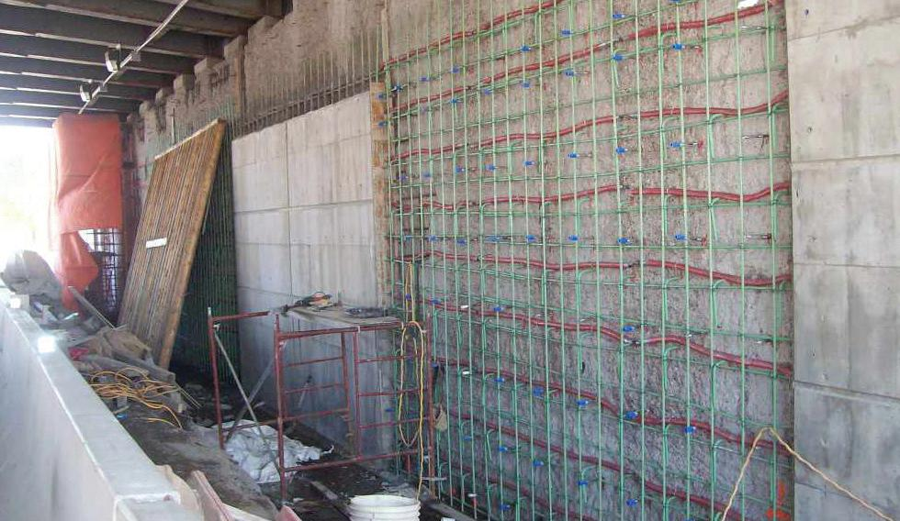
Distributed Galvanic Anodes

Slide 38
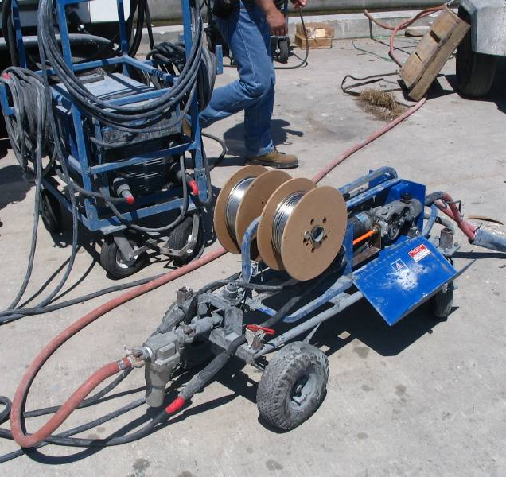
Arc Sprayed Zinc Anode

Slide 39
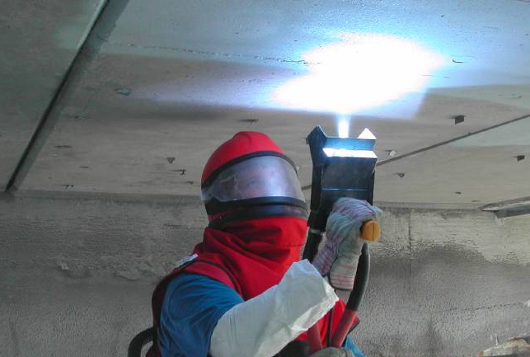
Arc Sprayed – Surface Applied Zinc

Slide 40
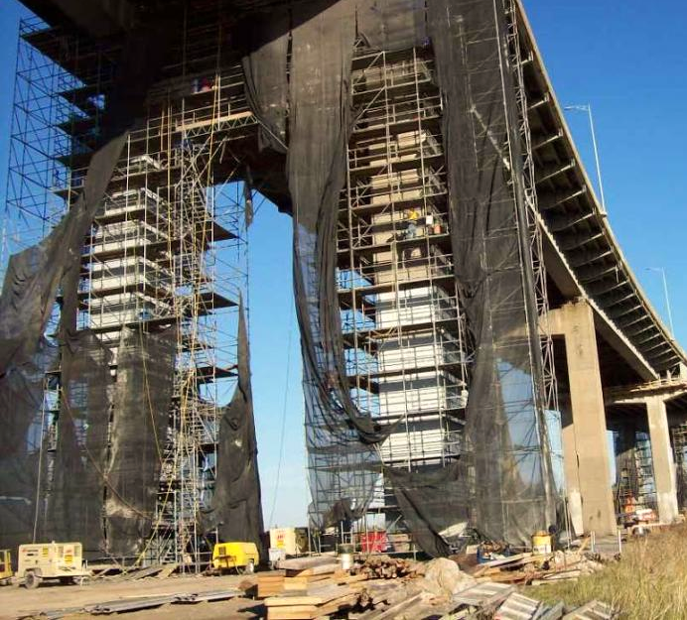
Arc Sprayed Zinc Anode

Slide 41
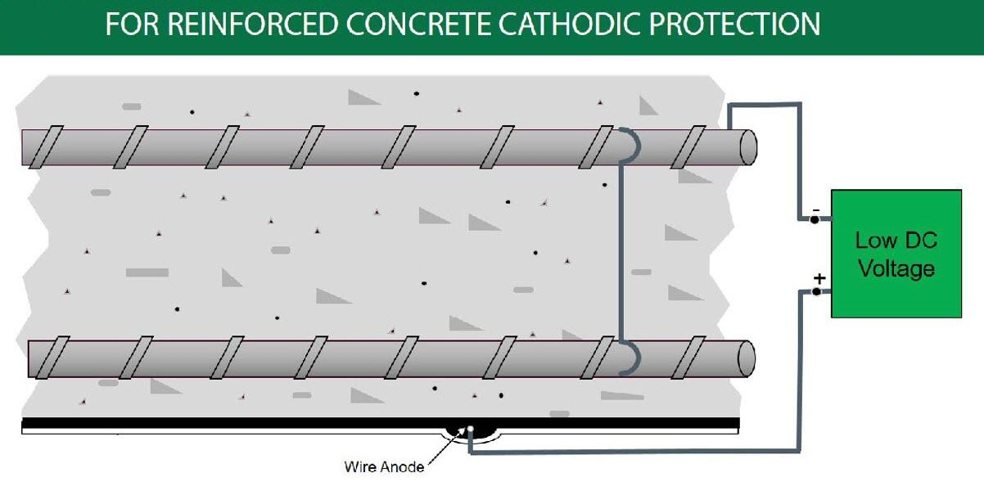
ICCP System – DC Powered

Slide 42
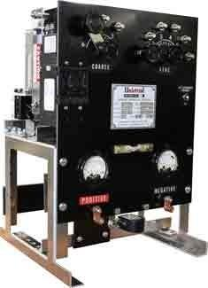
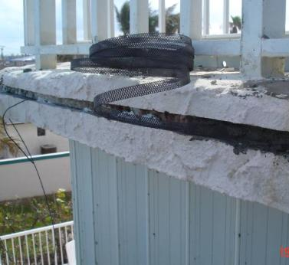
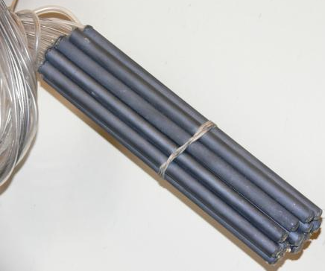
ICCP System – DC Powered
Use a AC to DC rectifier for system current
Require CP Design Engineer
Require maintenance
Made of an inert metal (Titanium)
Typically used for global protection
Notes:
Embedded
Conductive overlays
Ribbon
Mesh

Slide 43
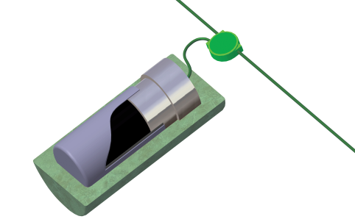
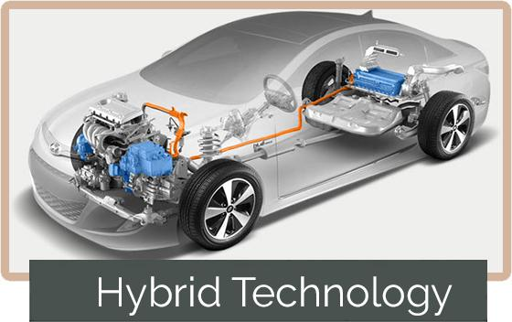
Hybrid Anode Technology

Slide 44
Hybrid Anode Technology

Slide 45
Hybrid Anode Technology

Slide 47
Hybrid Anode -Data

Slide 48
Corrosion Monitoring / Evaluation
Corrosion Monitoring
Used to alert the onset of corrosion or to determine corrosion progression over time.
Corrosion rate
Corrosion potential
Chloride penetration
Concrete resistivity
Temperature
Relative humidity
Stray current
Cathodic Protection Monitoring
Measures the performance and the service life of the various protection systems.
Anode current
Corrosion potential
Polarization
Temperature
Rectifier monitoring & control

Slide 49
Summary
Perform Corrosion Evaluation to fully understand the problem
Point Anodes for local protection
Distributed Anodes for Global protection
Various Types and sizes of Galvanic or ICCP systems
Options for monitoring and evaluation corroding structures

